Slide 1
College Management System
Project by:
Prasad Hole
Harshada Choure
Guide by:
Gayathri Mam

Slide 2
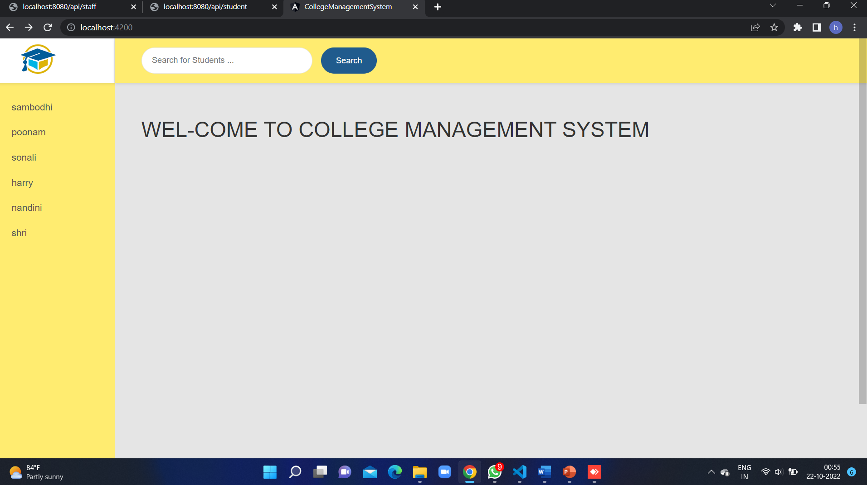
Welcome Page

Slide 3
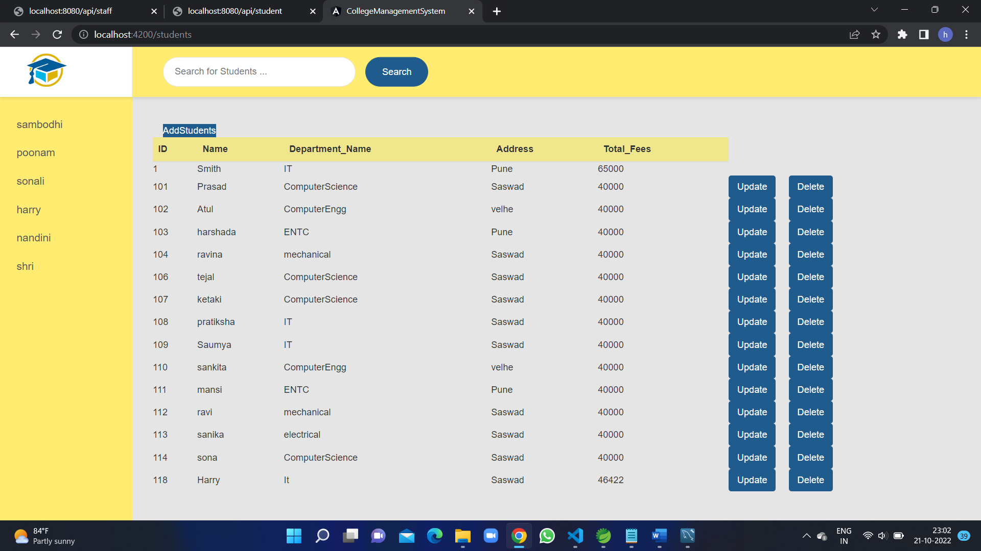
Student List View Page

Slide 4
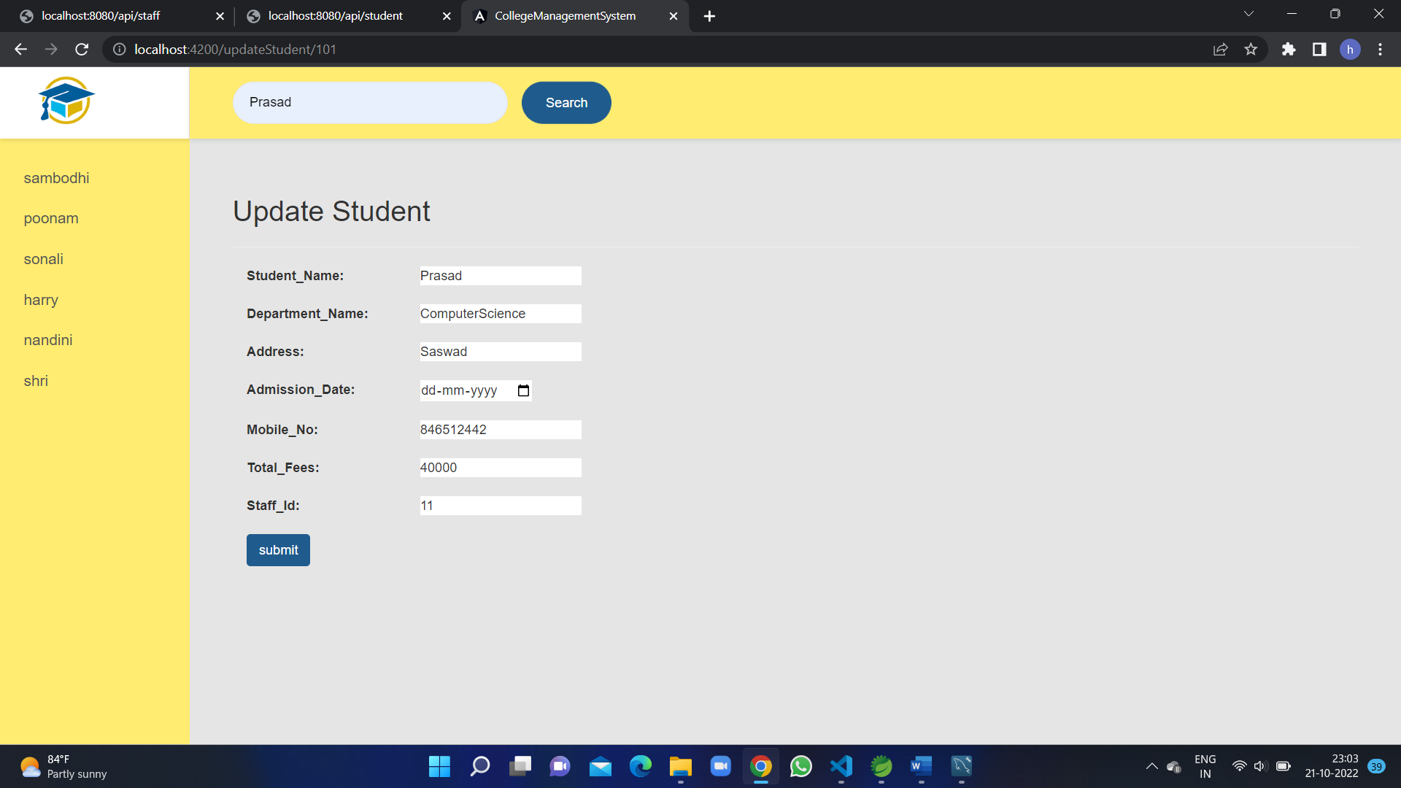
Update page

Slide 5
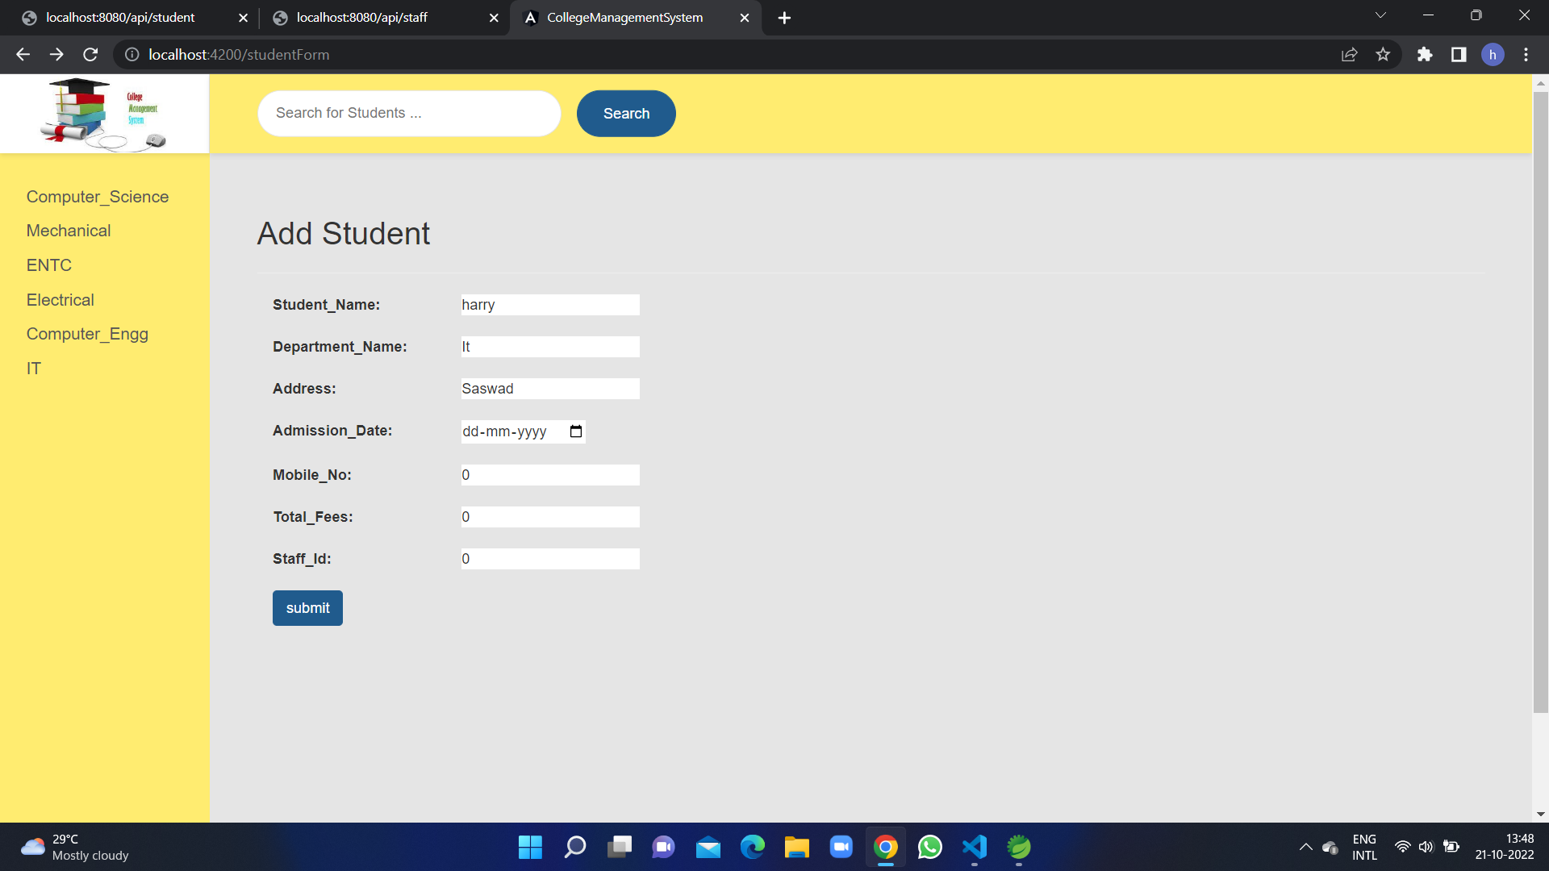
Add Student Form Page

Slide 6
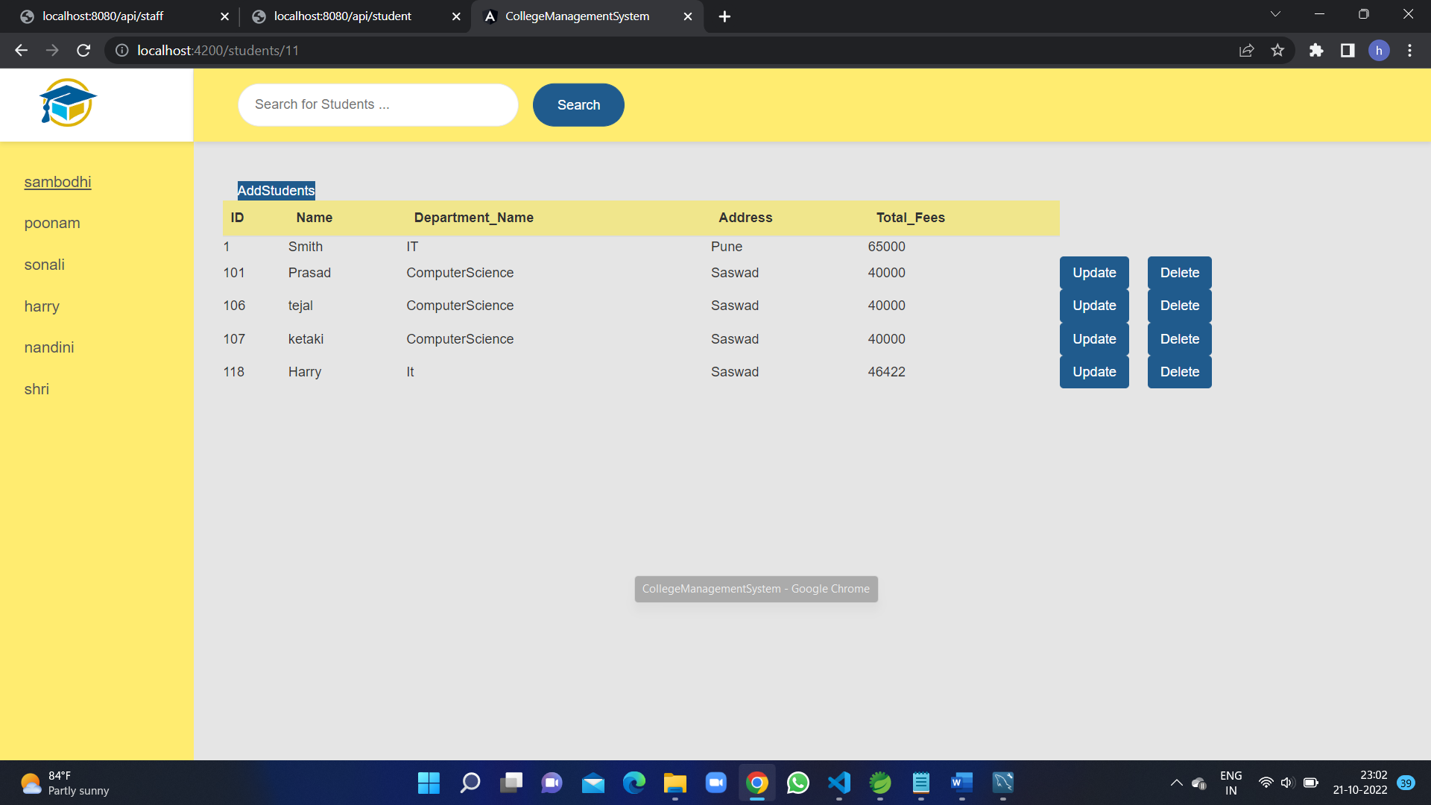
Student list call by Id

Slide 7
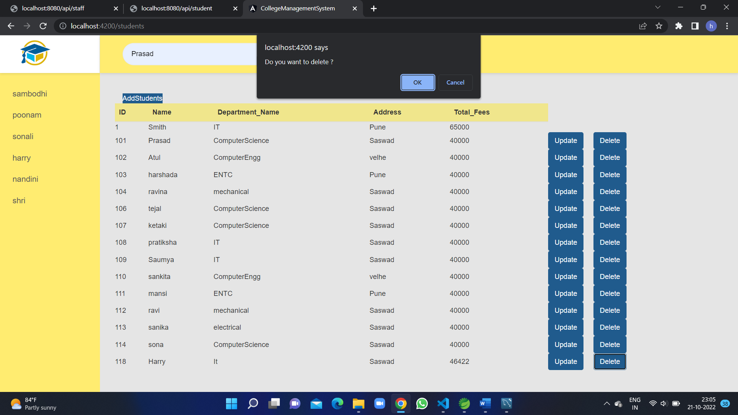
Delete Student Page

